Slide 1
Manipulating Arrays

Slide 2
Credits
Some of the contents of this slide presentation have been referenced and reproduced from the textbook for this course, PHP Programming with MySQL (Second Edition) , Don Gosseling, Diana Kokoska, and Robert Easterbrooks, ©2011, Cengage Learning, All Rights Reserved. ISBN 978-0-5387-4584-0.
Thank you for some references to Kevin Skoglund, from PHP with MySQL Essential Training (2013), ©2017 LinkedIn Corporation.

Slide 3
LEARNING OBJECTIVES
Manipulate array elements
Declare and initialize associative arrays
Iterate through and array
Find and extract elements and values
Sort, combine, and compare arrays
Understand multidimensional arrays
Use arrays in Web forms

Slide 4
Manipulating Elements
Introduction
Arrays are the main data structure used in Web programming
Indexed arrays: referred to by numeric position
Associative arrays: referred to with alphanumeric key
Effective use of the structure requires element manipulations
Adding elements
Removing elements

Slide 5
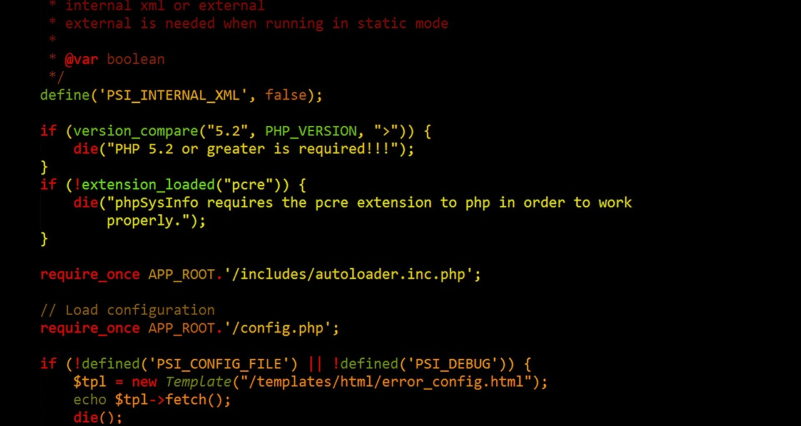
Manipulating Elements
Programming Exercise 02_06_01 – Step 1
All-in-one Form to Post Messages

Slide 6
Manipulating Elements
Programming Exercise 02_06_01 – Step 2
Create a Message Board

Slide 7
Manipulating Elements
Adding/Removing Elements – Array Beginning
The array_shift()function removes the first element from the beginning of an array
Pass the name of the array whose first element you want to remove
The array_unshift()function adds one or more elements to the beginning of an array
Pass the name of an array
Followed by comma-separated values for each element you want to add

Slide 8
Manipulating Elements
Programming Exercise 02_06_01 – Step 3
Removing Array Beginning Elements

Slide 9
Manipulating Elements
Adding/Removing Elements – Array Ending
The array_pop()function removes the last element from the end of an array
Pass the name of the array whose last element you want to remove
The array_push()function adds one or more elements to the end of an array
Pass the name of an array
Followed by comma-separated values for each element you want to add

Slide 10
Manipulating Elements
Programming Exercise 02_06_01 – Step 4
Removing Array Ending Elements

Slide 11
Manipulating Elements
Adding/Removing Elements Within an Array
The array_splice()function adds or removes the array elements
The function remembers the indexes in the array
Can add single elements, multiple elements, delete single elements, or delete multiple elements
Syntax

Slide 12
Manipulating Elements
Adding/Removing Elements Within an Array
To add a single element at a start point, use a value of 0 as third element and provide a value
To add multiple elements at a start point, provide an array constructor
To delete elements, specify number to delete as the value of the third element

Slide 13
Manipulating Elements
Programming Exercise 02_06_01 – Step 5
Building a Message Delete Feature

Slide 14
Manipulating Elements
Adding/Removing Elements Within an Array
The unset()function removes array elements by index number
Pass to the unset()function the array name and index number of the element to be removed
To remove multiple elements, separate each index name and element number with commas
Syntax
The array_values()function takes a sparse array and returns a newly renumbered array

Slide 15
Manipulating Elements
Programming Exercise 02_06_01 – Step 6
Modify Delete Feature to Use unset()

Slide 16
Manipulating Elements
Removing Duplicate Elements
The array_unique()function removes duplicate elements from an array
Pass to the function the name of the array from which you want to remove duplicate elements
The array_unique()function do not operate directly on an array, it returns a new array

Slide 17
Manipulating Elements
Programming Exercise 02_06_01 – Step 7
Removing Duplicate Elements

Slide 18
Manipulating Elements
Declaring & Initializing Associative Arrays
Associative arrays accept any alphanumeric keys
The key name can be a numeric or a string
Therefore, regular indexed arrays may be created with any starting point
Syntax
If you add a new element without a key, PHP assumes you want an index and sets the key to next available integer

Slide 19
Manipulating Elements
Programming Exercise 02_06_01 – Step 8
Declaring & Initializing Associative Arrays

Slide 20
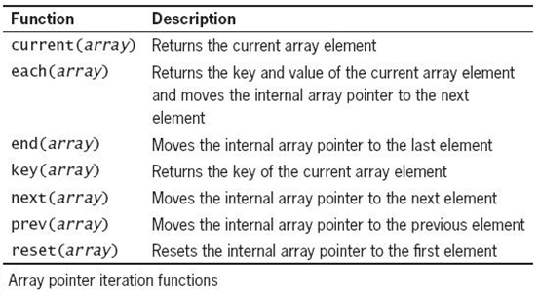
Manipulating Elements
Iterating Through an Associative Array
The internal array pointer is a special variable that refers to the current position in an array
PHP provides iteration functions to work with the pointer
Solves problem of associative array elements in unpredictable sequence

Slide 21
Manipulating Elements
Programming Exercise 02_06_01 – Step 9
Iterating Through an Associative Array

Slide 22
Manipulating Elements
Finding and Extracting Values
The basic method for finding a value in an array is to loop until found
PHP provides high level functions to do the job easily

Slide 23
Manipulating Elements
Determining if a Value Exists
The in_array()function returns a Boolean value of true if a given value exists in an array
The array_search()function determines whether a given value exists in an array
Returns the index or key of the first matching element if the value exists, or
Returns false if the value does not exist

Slide 24
Manipulating Elements
Determining if a Key Exists
The array_key_exists()function determines whether a given index or key exists
The function takes two arguments
The first argument represents the key to search for
The second argument represents the name of the array in which to search

Slide 25
Manipulating Elements
Programming Exercise 02_06_01 – Step 10
Determining if a Value Exists

Slide 26
Manipulating Elements
Sorting Arrays
There are numerous PHP functions to sort arrays
The most commonly used array sorting functions are:
sort()and rsort()for indexed arrays
ksort()and krsort()for associative arrays
If the sort()or rsort()functions are used on an associative array, the keys are replaced with indexes

Slide 27
Manipulating Elements
Programming Exercise 02_06_01 – Step 11
Sorting Arrays Ascending

Slide 28
Manipulating Elements
Programming Exercise 02_06_01 – Step 12
Sorting Arrays Descending

